Slide 1
POSITIVE DISCIPLINE!
January 10, 2017 MACC
“H” Rothenberg Co-Owner TRIPLE C CAMP Charlottesville, VA www.campcoach.com

Slide 2
Living in Illinois 1989-1999
Ingleside, IL
GLENBROOK

Slide 3
Living in Virginia 1999-2017

Slide 4
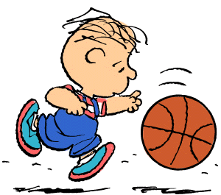
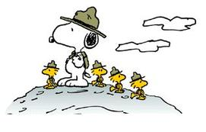
What can I share?

Slide 5
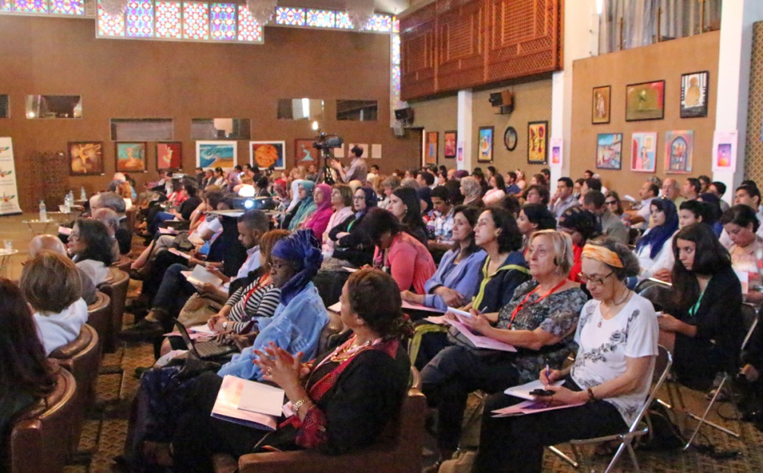
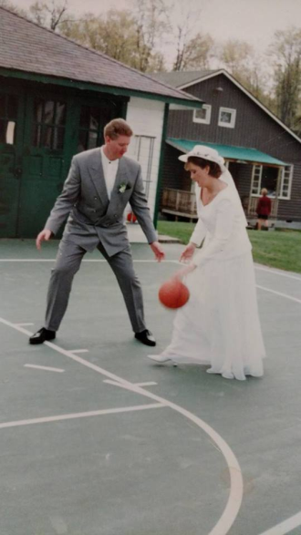
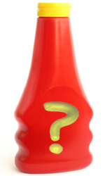
CONFERENCES
SECRET SAUCE
SPECIAL SAUCE

Slide 6
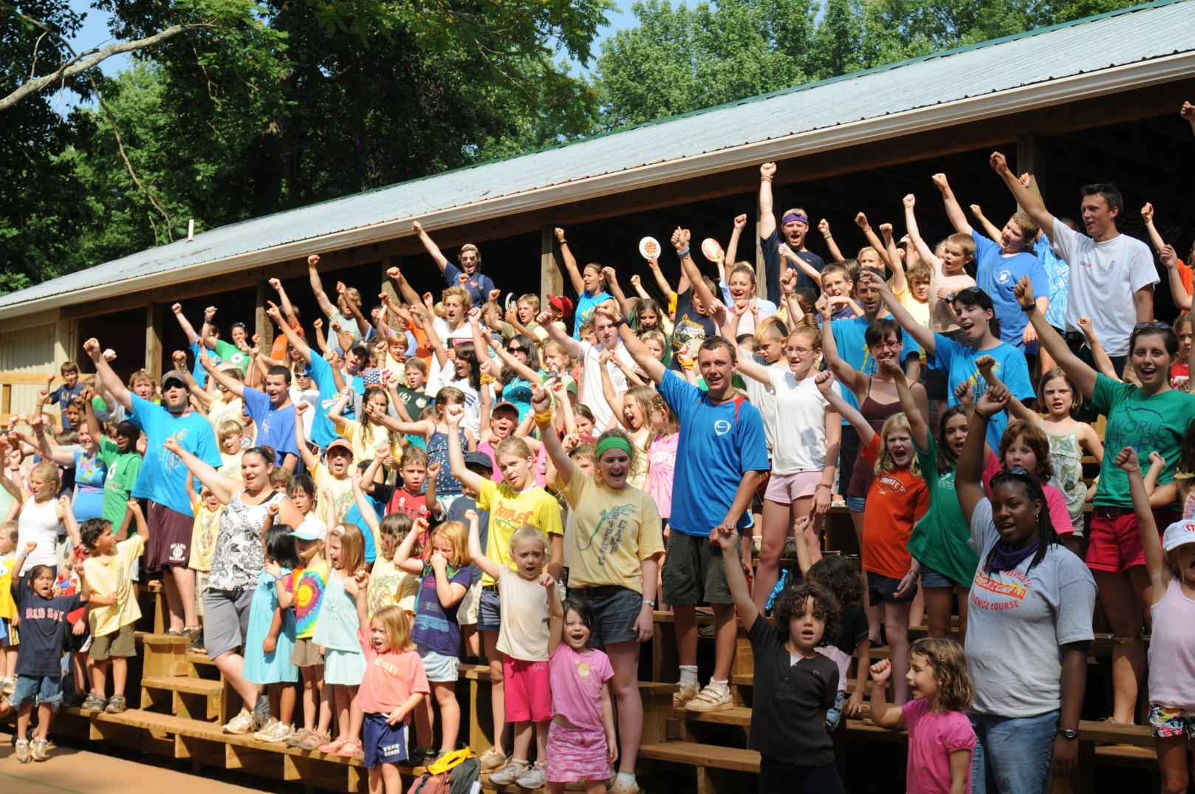
Beginning of each session/entire camp
COUNSELORS ARE IN CHARGE!

Slide 7
POSITIVE DISCIPLINE
POSITIVE DISCIPLINE
OUR PROGRAM

Slide 8
TOUGH TOPIC – TOUGH DECISIONS
Are you training your staff to spend time with a child one on one after EVERY misbehavior? Do your Counselors have the time?
Inform the child of the inappropriate behavior and let them know what is expected and why.
How and when do you communicate with parents regarding child's behavior?

Slide 9
Parents ask…”How do you handle discipline?”
“COUNSLEORS MAKE A HUGE DEAL OUT OF POSITIVES AND DEAL WITH THE NEGATIVES”

Slide 10
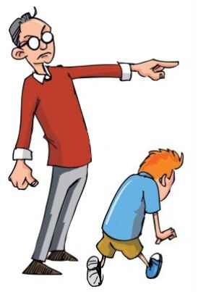
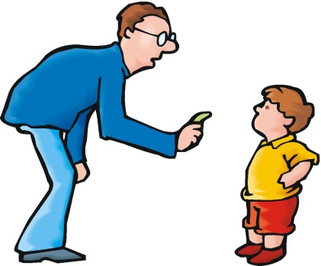
Webster’s Definition Discipline
“the practice of training people to obey rules or a code of behavior, using punishment to correct disobedience”

Slide 11
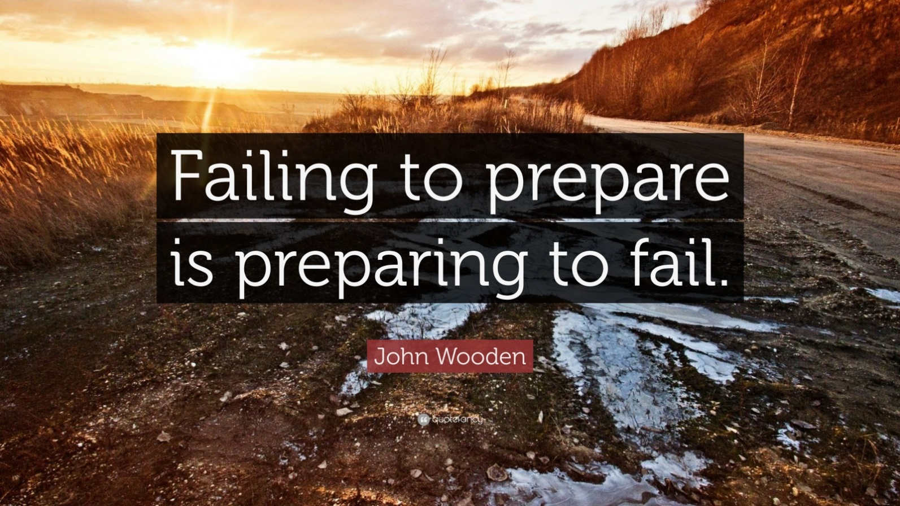
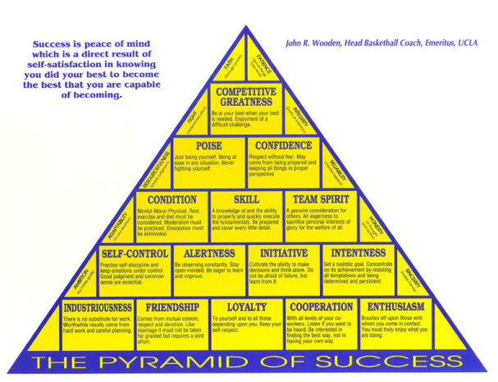
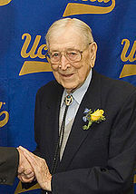
HAVE A PLAN

Slide 12
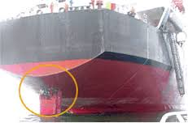
CLEAR EXPECTATIONS
Entire camp
At group level
Words like rudder of a ship
Notes:
So important to speak with our staff vs. at our staff….importance of PLEASE …smiling and impacting

Slide 13
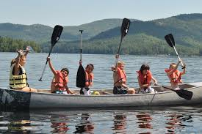
By defining behavior expectations and having a plan, we reduce behavior issues

Slide 14
Monday Morning Chart/Family Time
Things To Cover Every Monday With Campers
(Cover at some point during day, not necessarily all at once)
❑ Introductions, Names (Name Game)
❑ Orientation to Camp Facility
❑ Safety- shoes, rocks, woodchips, explain that rules are set to keep them safe
❑ Behavioral Expectations
Look at the person who is speaking
Respond, with “yes” when spoken to
❑ Our Group’s thoughts:
1-
2-
3-
❑ Counselor Expectations of campers, let them know you are here for them
❑ Goals Cabin group goals:
1-
2-
3-
Individual camper goals (give campers a chance to share what they want to accomplish at camp…may want to split group into smaller groups)
1-
2-
❑ Buddy Systems
❑ Bathrooms- where they are - washing hands after animals, using the toilet, and before meals
❑ Allergies- food allergies/contact allergies
❑ Lunch Procedures
❑ Animals – fingers in cages, dogs
❑ Leave no Trace- clean up after your group
❑ Platinum Rule- Treat others the way you know they want to be treated
Notes:
This is being done intentionally for organization, structure, interaction, learning about our campers …. Prevents behavior issues….better this goes, the better the session goes

Slide 15
Kapers chart
JOB | Mon | Tues | Wed | Thurs | Fri
Light Police - 2 campers Make sure lights are off, everywhere your group leaves. | 1 2 | 1 2 | 1 2 | 1 2 | 1 2
Snack Securers – 2 campers Collects snack bag & drink from dining hall at snack time. | 1 2 | 1 2 | 1 2 | 1 2 | 1 2
Snack Returners – 2 campers Returns snack bag & drink to dining hall, throws away any trash in dining hall. | 1 2 | 1 2 | 1 2 | 1 2 | 1 2
Lost Property Patrol - 2 campers Monitors items in cabin and when group moves from place to place. Prevents items from going to roundup Lost Prop. If any lost prop. in cabin at end of day, deliver it to round up. | 1 2 | 1 2 | 1 2 | 1 2 | 1 2
Dining Hall Duo- 2 campers Wipe down table and then sweep under and around table, collect debris and deposit it into appropriate receptacle. | 1 2 | 1 2 | 1 2 | 1 2 | 1 2
Waste Watchers – 2 campers Reminds group to prevent waste. All food waste on plates is scraped into bucket, weighed and charted. Prevents waste. | 1 2 | 1 2 | 1 2 | 1 2 | 1 2
Mailbox Monitors - 2 campers Monitors group’s mail box at am snack, after lunch, at pm snack and prior to Round up. Collect items and delivers to counselors. | 1 2 | 1 2 | 1 2 | 1 2 | 1 2
Cabin Sweepers - 2 campers As needed during the day, but specifically at the end of the day makes sure groups area and community bath room areas are swept. | 1 2 | 1 2 | 1 2 | 1 2 | 1 2
CABIN KAPER CHART WEEK ____________________
ONE COMMUNITY, ONE FAMILY
LEAVE ALL PLACES CLEANER THAN YOU FOUND THEM!!

Slide 16
Positive Words

Slide 17
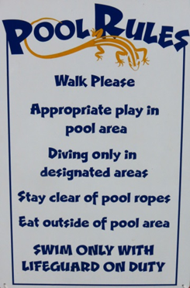
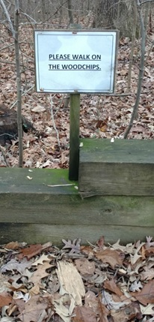
Examples in action…

Slide 18
PLEASE CLOSE YOUR EYES

Slide 19
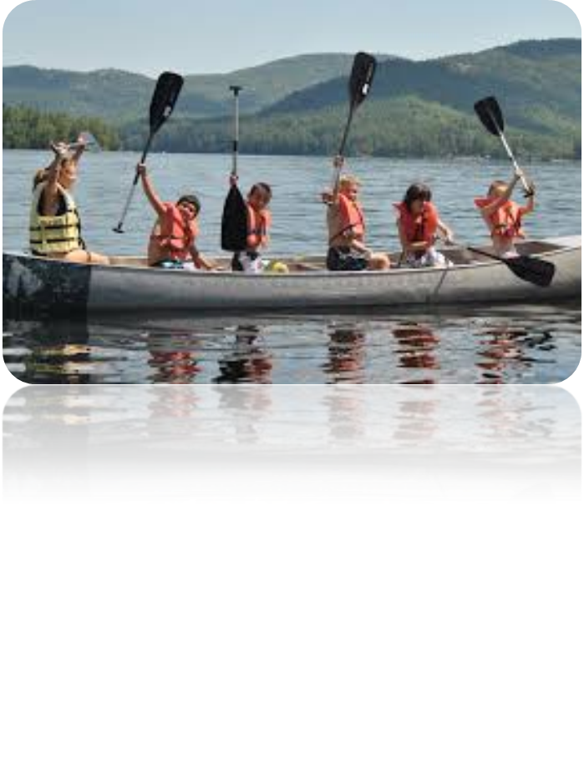
What could happen?

Slide 20
Why are the campers misbehaving?
What do they really want?
ATTENTION!

Slide 21
THIS IS THE SPECIAL SAUCE
CHOICES
CHOICES
CHOICES
Staff are in charge, staff frame the choices

Slide 22
Level I: Redirect
Redirect the child’s focus onto something positive
Avoid mentioning the negative choice- speak to the desired choice/outcome
Once redirected, move forward praising the positive choice (relationship building)
Child is getting positive attention
Other children- ripple impact

Slide 23
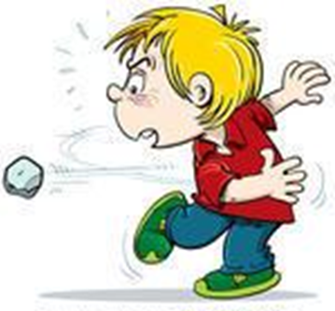
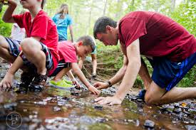
Johnny is throwing rocks in the creek
UNDESIRED BEHAVIOR

Slide 24
WHAT DO WE DO NOW?

Slide 25
What to do when the redirect doesn’t work?

Slide 26
Counselor: “Johnny, you have a choice to make…either ‘the desired behavior’ or a time out/reflection time”
Level II - CHOICES
Never mention the negative behavior. Focus on the positive… Only give attention to the desired behavior.
Notes:
Ask the audience who is in charge? They all say the Counselors….after 1(we believe in short in site time outs)

Slide 27
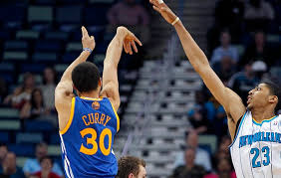
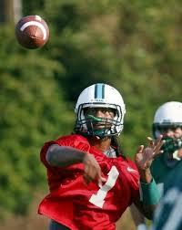
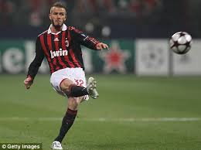
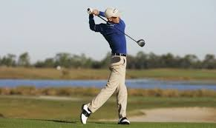
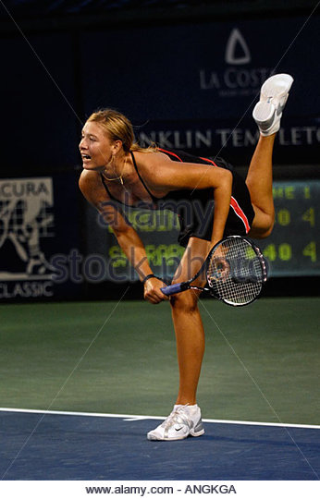
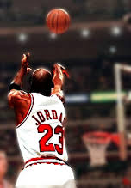
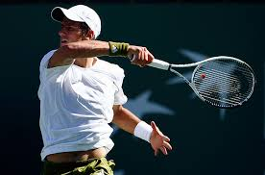
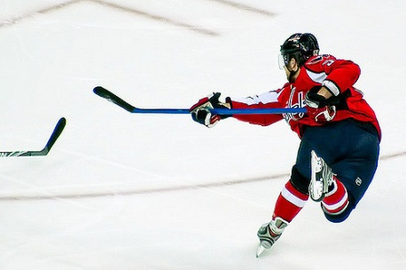
FOLLOW THROUGH

Slide 28
Any Questions?? Thru Level II

Slide 29
LEVEL III – Exterior support -more choices-
Johnny is still throwing rocks in the creek….
Counselor: “Johnny, You have a choice to make, either the time out/reflection time or I will radio for Mr. “H” to come discuss this with you.”

Slide 30
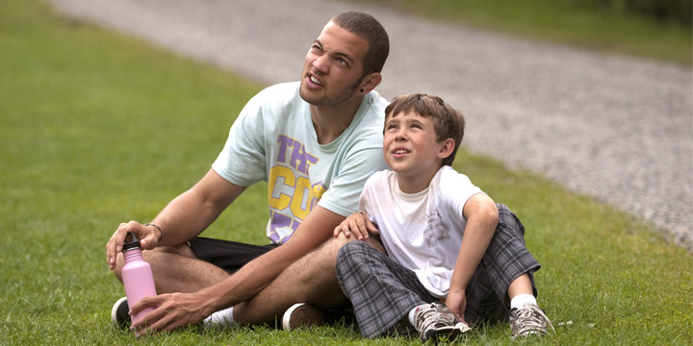
When camper rejoins group
Positively reinforce smallest thing
Rebuild anything
that has been lost

Slide 31
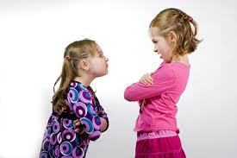
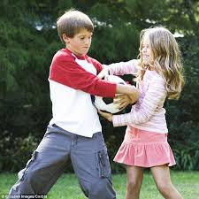
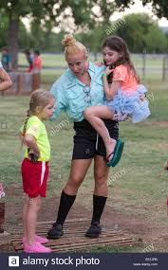
If two campers are having difficulties??
Great kids behaving less than perfectly
Allow child who was wronged to speak first

Slide 32
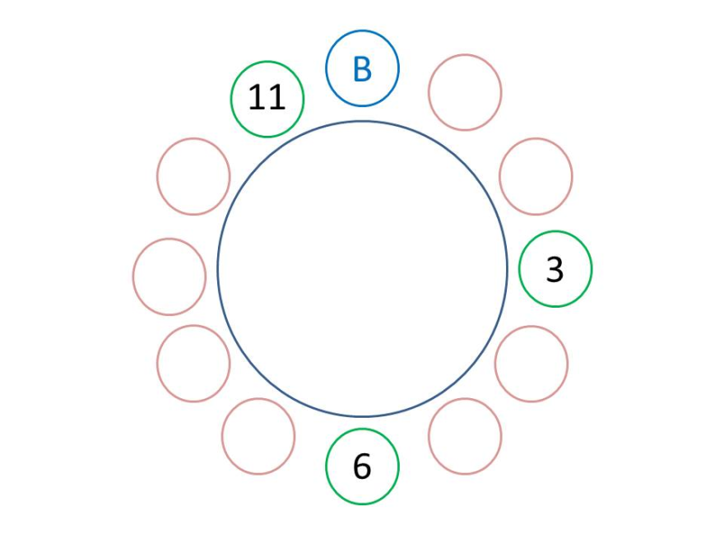
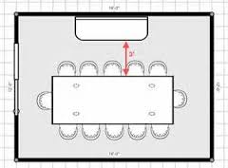
Physical placement in meeting is critical…be intentional
Try to come to agreement where campers can work together
Sometimes our agreement is to disagree
Notes:
On ground outside who faces the sun

Slide 33
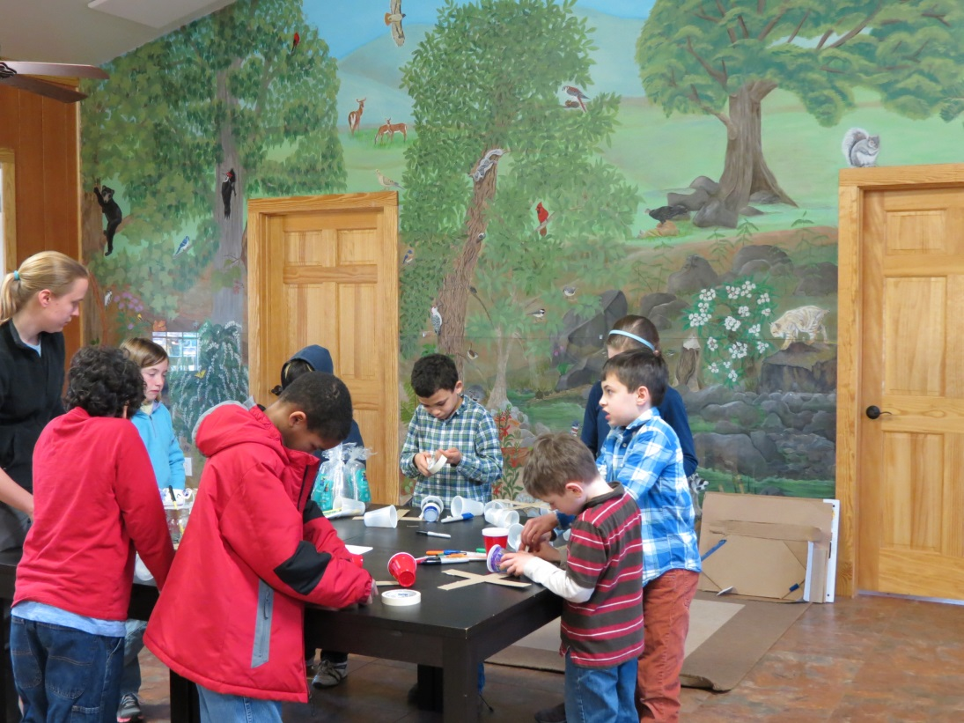
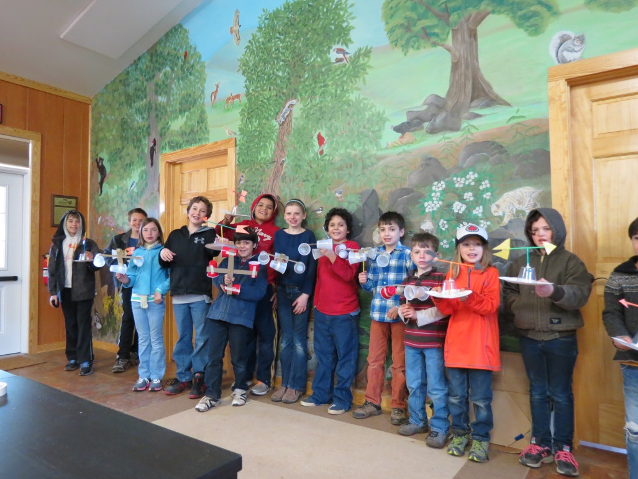
Entire group struggling
(mostly listening issues and frustrated Counselors)
Notes:
Listening, paying attention, follow directions, frustration for counselors…

Slide 34
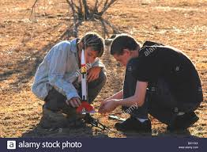
HANDS ON ISSUE
Automatic Level III
Director speaks with camper & then parent
Both campers at meeting
Leaving as friends, or friendly

Slide 35
FREQUENCY OF ADMIN VISIT
Minimal due to intentionality of program
This is a strategy designed for the entire camp
Time for situational role playing?

Slide 36
Difficult situation Scenarios
Redirecting:
Camper is pushing friend on a swing higher than Counselor is comfortable
Camper is sitting on another camper’s bed when everyone knows that camper HATES it when someone sits on their bed
Camper is imitating another camper with every word they speak

Slide 37
Two or more campers:
Two 3rd grade boys are at the drinking fountain and spraying and splashing. Usually friends, however went too far and they are angry with each other….looks like it’s about to get physical.
7th grade girls cabin getting ready for social with another camp. One girl has never worn make-up, doesn’t want to and the other girls are making fun of her.
6th grade boy camper does not want to participate in cabin clean up and is trying to get the other campers to go on strike!

Slide 38
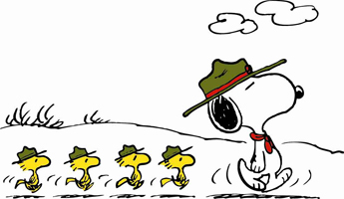
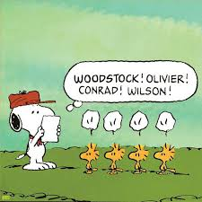
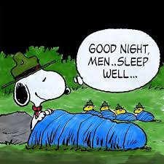

Slide 39
January 10, 2017 MACC
POSITIVE DISCIPLINE!
“H” Rothenberg Co-Owner TRIPLE C CAMP Charlottesville, VA www.campcoach.com

